Slide 1


CEA301
Application Development With Direct3D Mobile
John L. Marcantonio
Program Manager
Microsoft Corporation

Slide 2
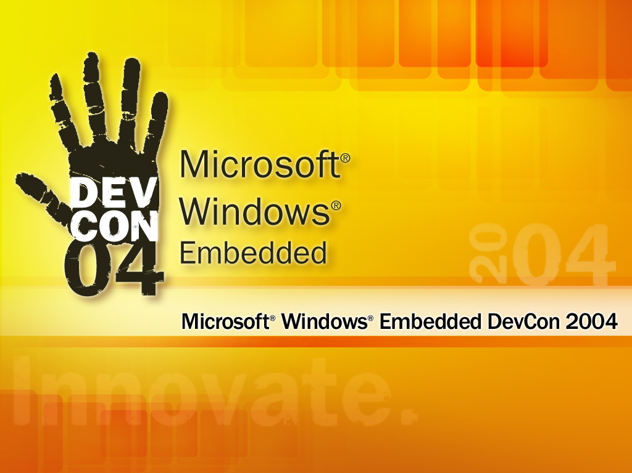

Slide 3


Agenda
What is Direct3D Mobile (D3DM)
Key Features
Architecture
Differences From CE D3D8
Code Walkthroughs
Q+A

Slide 4



What Is Direct3D Mobile
Complete 3D graphics API for mobile and embedded devices
Derivative of the Direct3D API
  COM-based D3D style programming model built on D3D 8 API Signature
    Initially designed for DX6 level hardware
    Includes some aspects of DX9
Designed to replace CE D3D8 in CE 5.0

Slide 5

Goals Of Direct3D Mobile
Easy access to current and future graphics features of embedded platforms
Implemented in small code size and memory footprint
Type independent supporting fixed and floating point data types
  IEEE 32-bit floats
  16.16 fixed point

Slide 6
What DX Offers Developers
Fast API Ramp Up
  Desktop developers can migrate quickly
  and easily
  Commonality across platforms – unified development knowledge
Large Knowledge Base
  Years of knowledge and experience with DX
  Wide community of DX developers
  Leveraged experience in the mobile space

Slide 7
Why DX On Windows CE
DirectX Knowledge Base
  Years of DX use by developers
  Familiar APIs and functionality to ISVs
Content Availability
  Content written to older versions of DX
  Out of date for the desktop but remains suitable for mobile devices

Slide 8
Why Create D3DM?
Footprint and memory constraints
  Current D3D carries high memory requirements
    ~1MB footprint
  SW emulation fallback for many routines
    These can be unused code paths
Native Processor Data Types
  Many embedded systems do not have integrated FPUs
    D3D is floating point intensive in design
    SW floating point emulation carries high performance cost
    Embedded 3D solution should support fixed and float

Slide 9
Why Create D3DM?
Embedded System characteristics
  Embedded systems vary in their capabilities
    CPU only
    DSP
    SIMD
    Graphics HW
  Drive model should leverage the capabilities of each of these systems

Slide 10
Why Create D3DM?
Targeted applications
  Mobile content development
    Gaming applications
  Navigation systems
    Mapping, GPS, Telematics
  Device UI
    Advanced 3D effects for UI development
    Complexity of UI design increases with smaller screen resolutions
Create uniform 3D graphics API across CE and Windows Mobile based devices

Slide 11
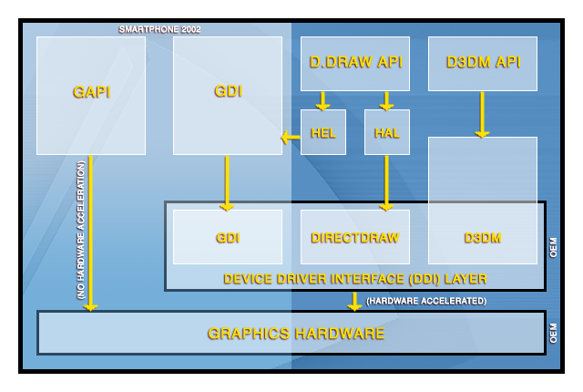
Architecture Overview

Slide 12
D3DM Architecture
D3DM is based on a Thin API / Thick Driver Architecture
  API Middleware (~50KB ARM Retail)
    Call Transport
    Synchronization
    OS Integration
  Driver (~100KB+) – Actual Drawing Services
    Pure SW (CPU Only)
    SW + HW Assist (SIMD, DSP)
    Pure HW (External Graphics Controller)
Simplified DDI
  Compared to the desktop the DDI complexity has been reduced significantly (~30 to ~10)

Slide 13
D3DM Driver Types
Locally Hooked Driver
  Loads the D3DM driver in app process space
  Leverage Direct Draw for surface management to frame buffer
  Primarily for SW based drivers
Remotely Hooked Driver
  Loaded in GWES
  Identical to CE display driver architecture
  Designed to access graphics HW
Hybrid Model
  Combined traits of local and remote hooked

Slide 14
Differences From CE D3D8
Type Independent Data Support
  A compliant D3DM driver requires support for both
    IEEE 32-bit Floats
    16.16 Fixed Point
Fixed Function Pipeline Only
  D3DM does not support programmable pipelines
  VS/PS support being considered for future revisions
D3DM is not tied explicitly to Direct Draw
  Direct Draw surface management can be leveraged by SW based D3DM drivers

Slide 15
APIs From DX9
StretchRect
HRESULT StretchRect( IDirect3DMobileSurface* pSourceSurface,
CONST RECT* pSourceRect,
IDirect3DMobileSurface* pDestSurface,
CONST RECT* pDestRect,
D3DMTEXTUREFILTERTYPE Filter
);
Copy rectangular region from source
to destination
Include size, filter, and color format conversions

Slide 16
APIs From DX9
CopyRect
BOOL CopyRect( LPRECT lprcDst,
const RECT* lprcSrc
);
Copies coordinates from one rectangle to another

Slide 17
Microsoft-Provided Components
D3DM Middleware
  Does not contain SW fallback routines as the desktop
    This functionality pushed down to the driver
  OS integration and call transport to driver
  Integrates with DirectDraw for surface management (not required)

Slide 18
Microsoft-Provided Components
D3DM Reference Driver
  Complete SW driver implementation of D3DM v1.0 definition
  Not performance oriented, designed as a QA tool
  Can be loaded and used for application development
    While fully featured, use fast platform for “reasonable” performance

Slide 19
D3DM Drivers
D3DM drivers are required for any given platform
CE 5.0 driver support includes
  NULL Driver Framework
  SW Reference Driver
  X-Scale® Optimized SW Driver
Functionality is based on what the driver exposes

Slide 20
Current Partners
IHV Partners
  Intel
  TI
  Samsung
Graphics HW Partners
  NVIDIA
  PowerVR (Imagination Technologies)
  ATI
More joining…

Slide 21
Loading The Reference Driver
Load the locally hooked Reference Driver
HMODULE hRefDLL = (HMODULE)LoadLibrary("d3dmref.dll");
if (NULL == hRefDLL)
{
OutputDebugString("Unable to load d3dmref.dll\r\n");
return E_FAIL;
}

Slide 22
Loading The Reference Driver
Get driver entry point address
void * pfnD3DMInit = (void *)GetProcAddress(hRefDLL, "D3DM_Initialize");
if (NULL == pfnD3DMInit)
{
OutputDebugString("Unable to retrieve D3DM_Initialize entry point.\r\n");
return E_FAIL;
}

Slide 23
Loading The Reference Driver
Create the D3DM Object
IDirect3DMobile* pd3dm = Direct3DMobileCreate(D3DM_SDK_VERSION);
if (NULL == pd3dm)
{
OutputDebugString("Failed to create D3DM object.\r\n");
return E_FAIL;
}

Slide 24
Loading The Reference Driver
Register the reference driver
HRESULT hr = pd3dm->RegisterSoftwareDevice(pfnD3DMInit);
if (FAILED(hr))
{
OutputDebugString("Unable to register the software device.\r\n");
return hr;
}

Slide 25


D3DM Reference Driver
Demo

Slide 26
D3DM Sample Walkthrough:
TwoTri
Demo

Slide 27
D3DM Sample Walkthrough:
Vertex Buffers
Demo

Slide 28
D3DM Sample Walkthrough:
Advanced Samples
Demo

Slide 29
Further Information
Windows CE 5.0 documentation
  Driver / application development guide
Desktop SDK / MSDN D3DM Documentation
  Many desktop concepts and APIs are applicable to D3DM
  Knowledge from the desktop can be applied to D3DM development
CE Newsgroups

Slide 30
Questions?

Slide 31

Microsoft
©2004 Microsoft Corporation. All rights reserved.
This presentation is for informational purposes only. Microsoft makes no warranties, express or implied, in this summary.

